Slide 1

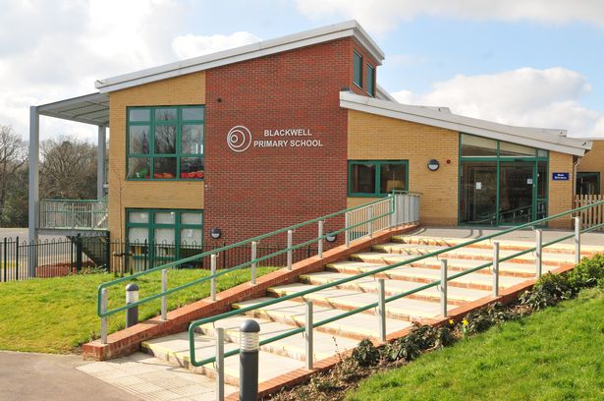

Welcome Meeting
2023

Slide 2
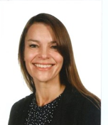
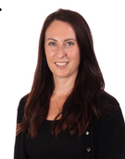
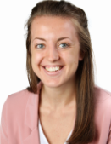
Key Members of Staff
Mrs Martin
Headteacher
Mrs Turner
Teacher and EYFS Lead
Miss Akehurst
SENDco

Slide 3
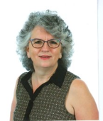
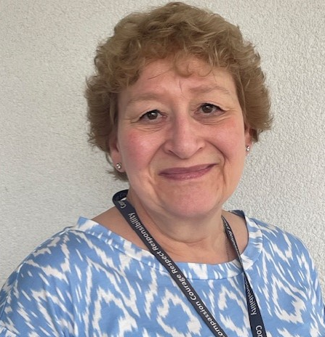
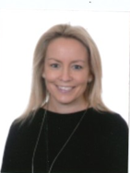
Office Staff
Mrs Bulford
Receptionist
Mrs Currid
Secretary
Mrs Devlin
Finance Assistant

Slide 4
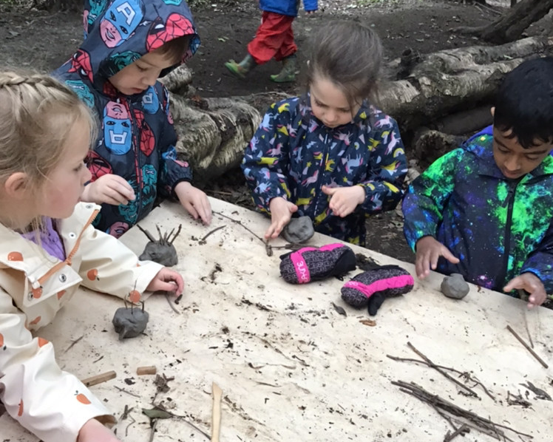
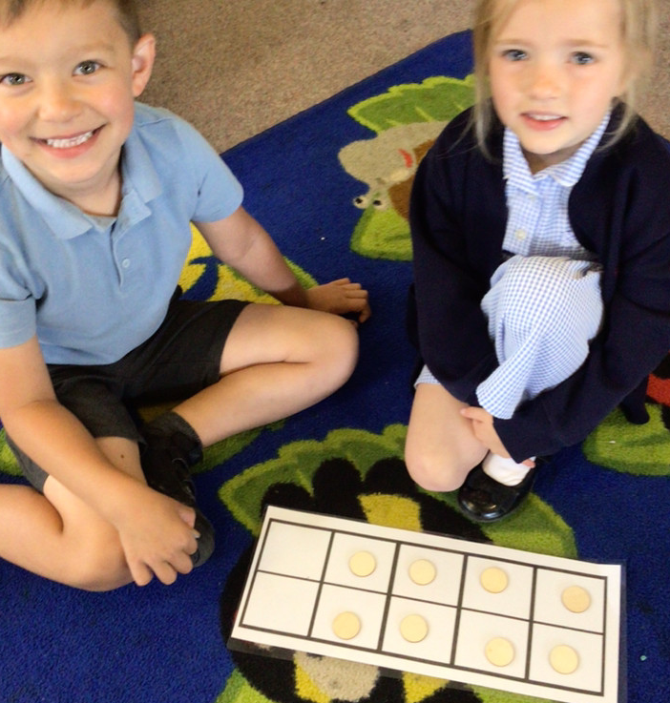
Tonight’s Meeting
Cover key dates and information
To help your child make the best possible start to school
To help you to understand the EYFS Curriculum that your child will be covering in Reception
To identify ways you can support your child at home and in school

Slide 5
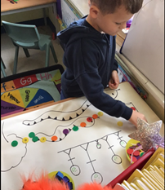
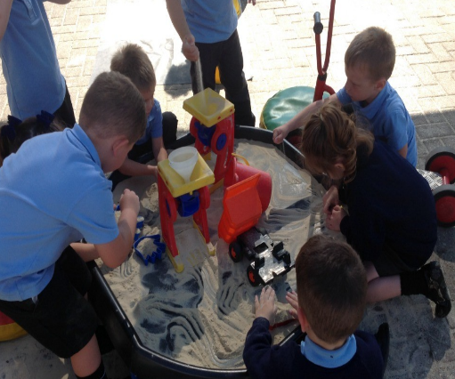
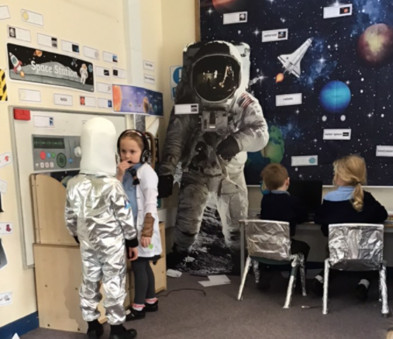
Stay and Play Sessions
Monday 30th June 2.15-2.45 (Children + 1 adult)
Wednesday 9th July 1.45 – 2.45 (Children + 1 adult)
Monday 14th July 9.30 – 10.30 (Children only)

Slide 6
September 2025
Thursday 4th September | Home Visits
Friday 5th September | Home Visits
Monday 9th September | Home Visits
Tuesday 10th September | Home Visits
Wednesday 11th September | 8.35 – 12pm All reception children in school
Thursday 12th September | 8.35 – 1pm All reception children in school and staying for lunch
Friday 13th September onwards | Usual whole school day 8.35 – 3.05pm
“I think the ‘quick’ starting school is brilliant – much better to get them started quickly than dragging out for several weeks.”
“I think that the start to school has been excellent. I am very pleased my son is attending Blackwell Primary.”

Slide 7
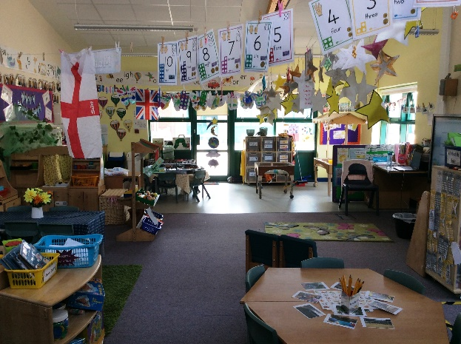
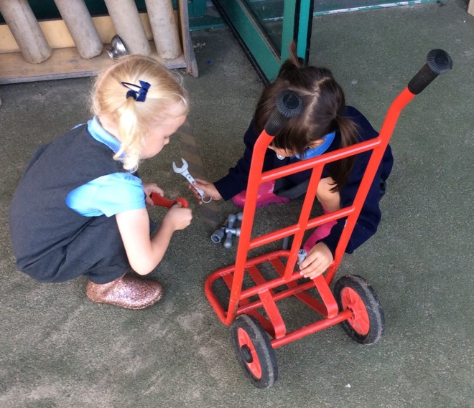
Transitioning into Blackwell
Stay and Play sessions x 3
Nursery/pre-school handovers
Home visit in September (sign up tonight or during Stay and Play sessions)
Transition booklet to look through at home
Welcome video during summer break

Slide 8
Beginning and end of day arrangements
Doors open at 8.35am. Reception children have their own entrance
We ask that parents and carers say goodbye outside of the main entrance and that the children walk into school themselves. The children will be supported by staff to reach their classroom. This has worked very well over the last few years in settling the children quickly.
Home time is at 3.05pm. Children are collected from the Year R area behind the fence. The children will come out of the far hall door. We have continued to use our one way queueing system which works well to ensure that the children reach you safely at the end of the day.
Limited parking and we encourage walking to school where possible.
Please let us know if someone different will be collecting.

Slide 9

Wrap-Around Care
Breakfast Club
7.45am -8.35am
Afterschool Club
3.05 – 6.00pm
Both held on our school site and run by All Kids Ltd.
www.allkidsltd.co.uk

Slide 10
Find Out Friday
Every Friday Afternoon from 2.50-3.05pm
Attended by almost all parents and carers each week. It is a fantastic opportunity to find out what the children have learnt that week with a focus on the letter sounds and harder to read and spell words that are taught in phonics.
Feedback from parents and carers has been very positive with lots feeling more confident about how to support their child with phonics at home.
“Find out Friday has been really good to see how well they are all doing.”

Slide 11
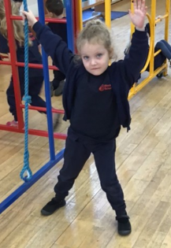
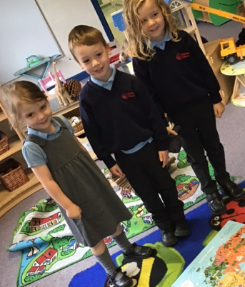
Uniform and PE kit
Information about school uniform can be found on our website with the link to mapac the uniform supplier.
PTA run pre-loved uniform sales throughout the year.
More information regarding our school uniform is available on our website.
PE kit required for PE days. Usually 1 day a week in Reception. PE days will follow in the Autumn term.
Please can you label all school uniform.

Slide 12
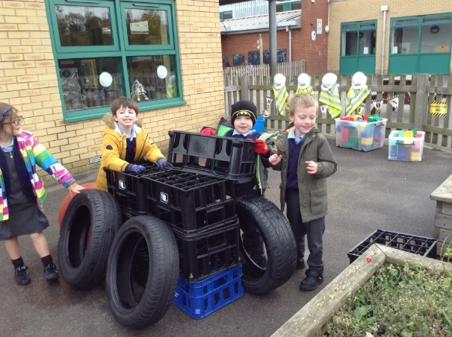
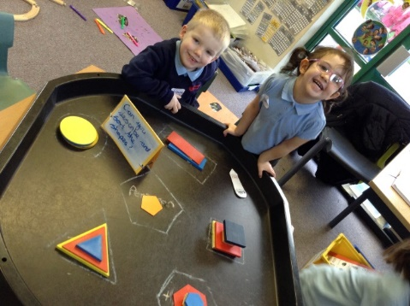

The Foundation Stage Curriculum
The children are not confined to subject areas. Children are working towards achieving the Early Learning Goals (ELGs) by the end of the year.
        Planned learning experiences are based on the children’s interests.
        Skills are developed through a play based curriculum.

Slide 13
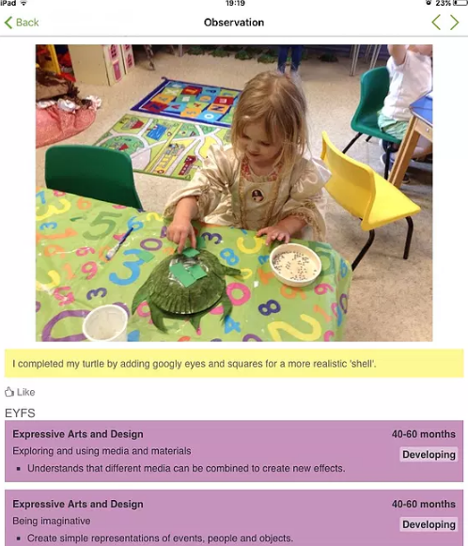

Allows you to stay up to date with your child’s learning and development
Children can share their learning with you at home
Parents/carers can add significant home learning to share in school
Please complete the permission form in order for us to link to your child’s account

Slide 14




Reading at Home
We will begin them on the coloured book banded levelled books. These books are for them to read to you. They will come home on a Friday and are returned to school the following Thursday.
Books will come home in book bags
Please record their reading in their reading diary when you have read with your child. They will receive a class dojo after each full week of reading.
Your child will have a phonics folder which will have new sounds and harder to read and spell words in each week. Please help them to practise these at home.
Remember the key to reading success is lots of practise (everyday) and lots of praise!

Slide 15

All About Me Books
Photos of family and friends
Drawings
Pets
Special things
Likes and dislikes
Leaflets from days out and trips
Certificates/badges
Clubs
This can be completed and added to throughout the Summer break and your child/ren can bring it into school with them when they start in September.

Slide 16

Daily Snack
Milk – free until your child’s 5th birthday. Then available at a small cost. Please complete the online form at www.coolmilk.com
Fruit – one piece a day delivered by West Sussex County.

Slide 17

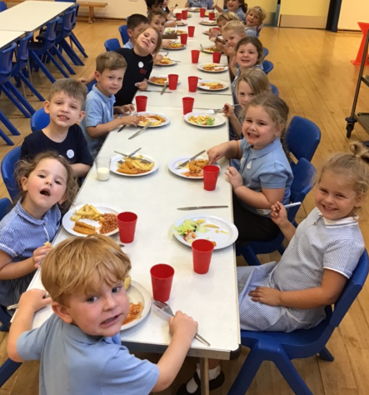
Lunchtime
Your child will either have a free hot school meal (Chartwells) or a you will need to provide a packed lunch. Meals are selected by parents through the Parent Pay.
Packed lunches:
- nut free
- no chocolate or sweets
The children eat their lunch in the hall with the other children and then go
out to play on the main playground.
Water bottle ofwater (no squash)
Free School Meals – All children from Year R to Year 2 are currently entitled to Universal Infant Free School Meals. In addition to this, if you are in receipt of specific benefits, you are entitled to apply for Means-Tested Free School Meals, which will also result in Blackwell receiving a small grant to help support your child’s education.

Slide 18
Our Core Values

Slide 19

Preparing your child for school
Over the summer break supporting your child with the following will help prepare them for starting school:
Dressing – shoes and coats
Toileting
Using a knife and fork
Putting things away after themselves
Recognise and write their name
Time to take away dummies
Listening to and following instructions (listening games)

Slide 20
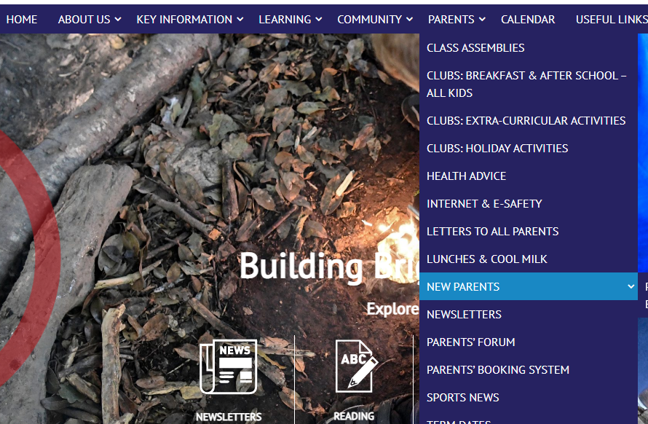
School Website
‘New Parents’ page has lots of information to support with your child’s transition into school.

Slide 21

School Communication
The office will communicate via email or through our communication system, Arbor. This will be used for booking clubs, trips and parent consultations.
You will receive an invitation to sign up via email.

Slide 22

Messages from the office
As part of the Office Team we are excited to welcome your child/ren to
Blackwell. To help us as much as possible please be mindful of the following:
We need to see a copy of your child’s birth certificate if we have not done
so already.
Keep contact details up to date as we may need to contact you about your child during the school day.
If your child is going to be absent, please phone the school to let us know
– the school answer phone is available from 7.00 a.m. Or you can inform us through Study Bugs.
Asthma – please obtain a spare inhaler and spacer from your doctor to keep in school. You will need to fill out a medication form, these are available from the school office.
Epipens – we will require two Epipens to be kept in school at all times.
The school can only administer medication once a medication form has been completed. Please see the medicines policy. Forms will need to be filled out at the school office.

Slide 23
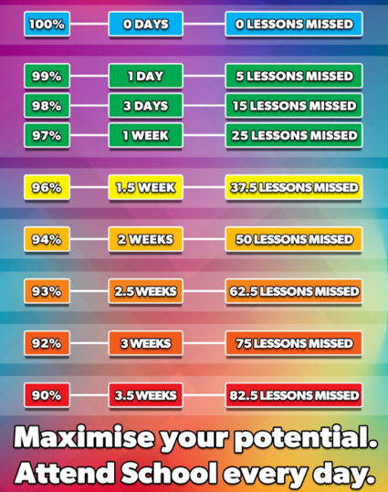
Attendance matters!
97% attendance is expected in school.
Attendance is closely monitored
We follow the West Sussex Attendance Policy and will not be able to authorise Term Time holidays

Slide 24
Checklists
Print a photo for peg
Complete All About Me book
Bag of spare clothes and underwear to keep on peg
Welly boots to keep at school
Named water bottle

Slide 25
Any Questions?
If you have any further questions please do not hesitate to email the school office who will forward your question to the most appropriate member of staff.
officebl@partnersinlearning.co.uk

Slide 26

Thank you for attending tonight.
We look forward to welcoming your child/ren soon.

